Slide 1
Machine Learning in the Trenches
Kevin Cartier
October 2017

Slide 2
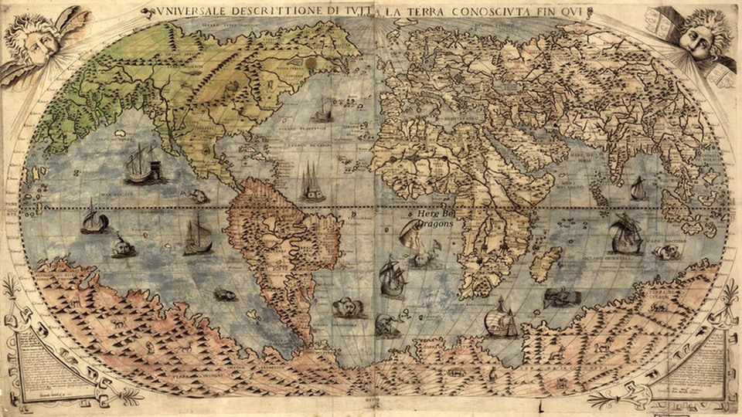
I Got 99 Problems, and an Algorithm Ain’t One
Data Quality
(Good luck with that)
Sample Size
Signal vs. Noise
Too Many Variables
Spurious Correlations
Curse of Dimensionality
Model Selection
Type III Error
Model Interpretation
Unknown unknowns
Black Swan Results
A Method for the Madness
CRISP-DM

Slide 3
An Ocean of Big Data … There Be Dragons Out There

Slide 4

Big Data?

Slide 5
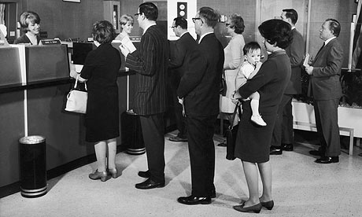

Back in the Day, We Just Called it “Data”
Historically, customer-related data sources were controlled by the enterprise.
Data characterized by
Homogeneity of record types
Predictable rate of acquisition
Relatively manageable quantities, scales
Customers conformed to the structures set in place by business

Slide 6
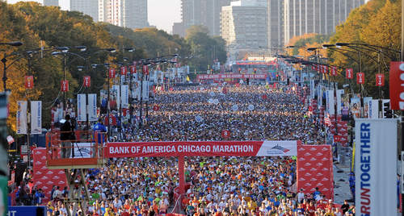
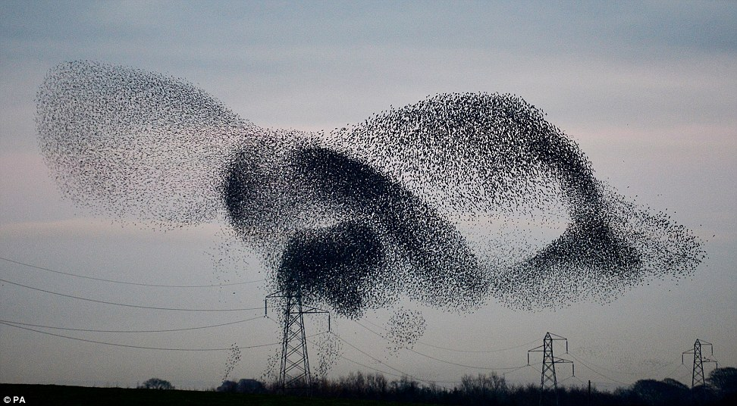
Things are a Little Different Now
Customers come at you whether you’re ready or not:
Multiple channels, formats
24 X 7
Internationally
Rapid, unexpected pivots of opinion, preference.
Business enterprises must increasingly meet customers on their own terms.
Customers now collectively bring “Big Data” to the enterprise, creating demand for a new approach to analytics.

Slide 7
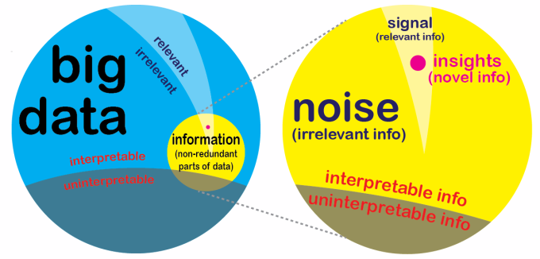
The “Fundamantal Theorem” of Big Data Quality
The vast majority of a given collection may be irrelevant, misaligned or otherwise incompatible w.r.t. existing systems & platforms.

Slide 8
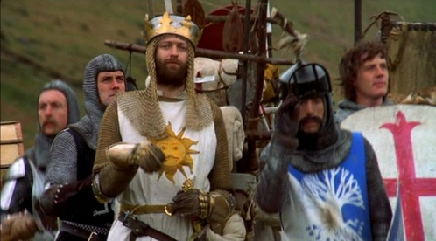
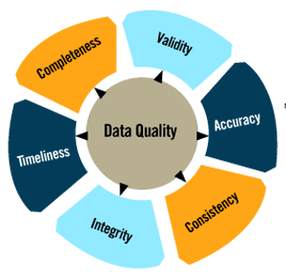
The Quest for Quality
Big Data brings all of the usual data quality challenges, only magnified.

Slide 9
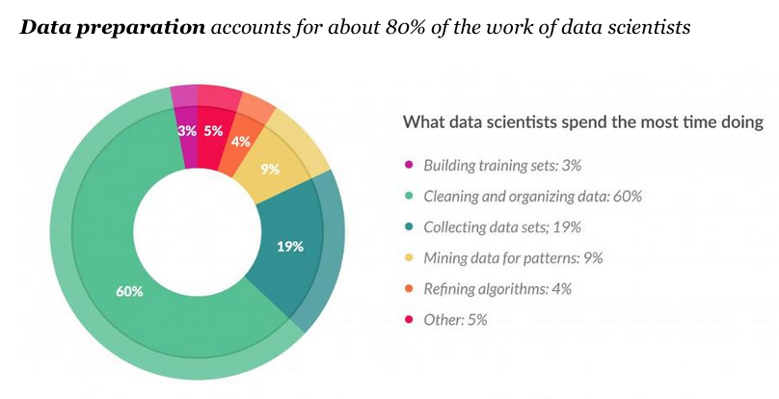

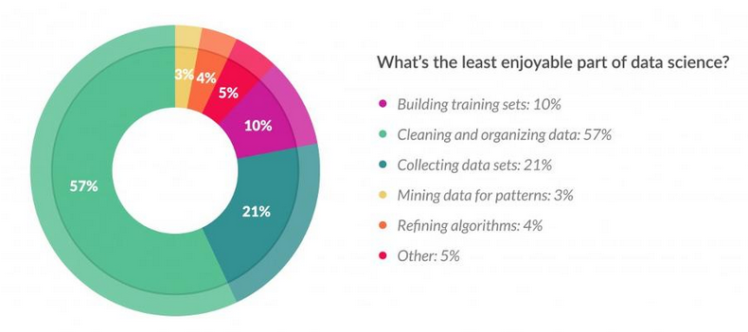
Quality Don’t Come Cheap
“It costs money because it saves money!”

Slide 10
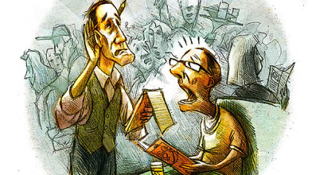
Signal vs. Noise
Talking to the waiter in a noisy restaurant is a classic signal-to-noise problem.
If only a few variables are informative to the problem at hand, we want to focus on those and “ignore” the rest.
In statistical terms, this approach is often accomplished by Bayesian methods for that explicitly model the bias-variance trade-off.

Slide 11
Noisy Text Streams
Bayesian methods allow us to inverse the probability statements … turn a “hard” problem into an “easy” one.
Classic example: “Naïve Bayes” filter for Spam:
Word streams are inherently noisy
How to discriminate between wanted & unwanted email messages?
P(spam | rolex, offer)
= P(rolex | spam)*P(offer | spam)*P(spam)
P(rolex)*P(offer)
= (0.62)*(0.56)*(0.31)
(0.24)*(0.62)
= 0.11/.15 = 0.73
Hard to calculate
Easy to calculate

Slide 12
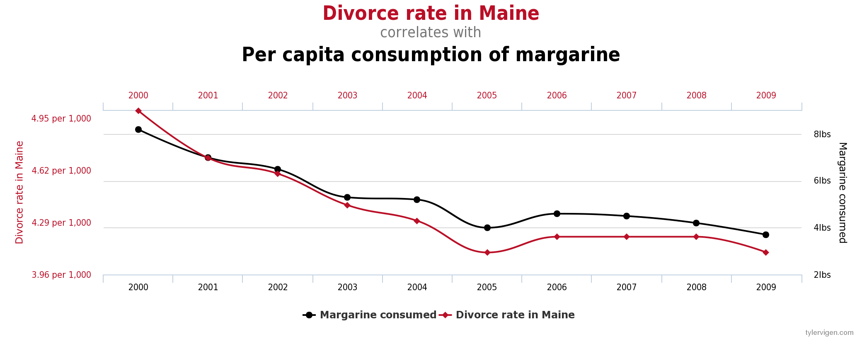
Spurious Correlations
“Correlation is not Causation”
Easy to say, but easier to forget … the literature is filled with cautionary examples.

Slide 13
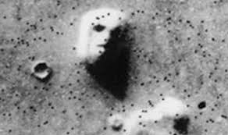
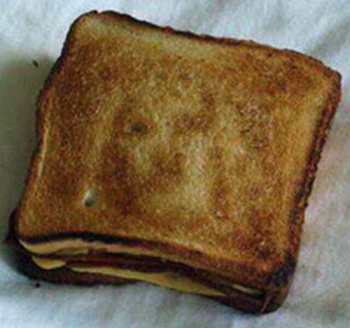
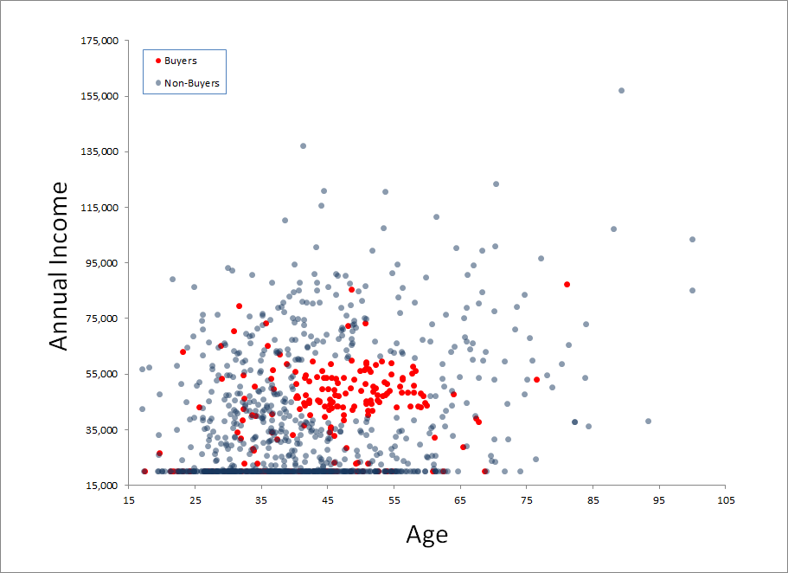
Seeing is Believing?
Evolution has made us good at spotting visual patterns (“pre-attentive processing”)
The more dimensions we analyze, the greater the chance of find a correlation between two more dimensions
Patterns that arise by random chance are given unwarranted significance

Slide 14
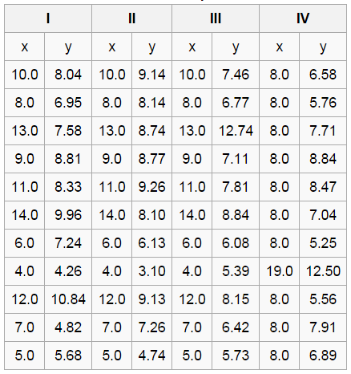
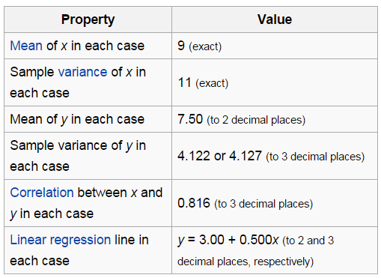
Can We Believe the Numbers?

Slide 15
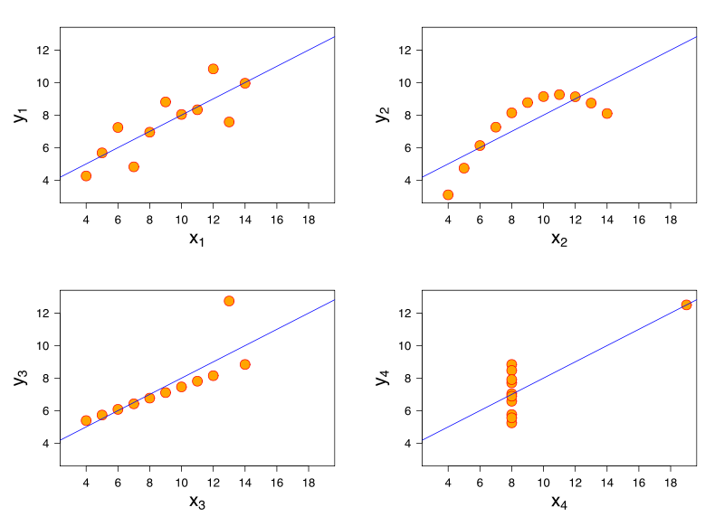
Anscombe’s Quartet
Linear relationship; normal residual error
Nonlinear relationship
Linear, but regression affected by outlier
Nonlinear, but correlation affected by outlier
Developed in 1973 by statistician Francis Ascombe
Highlights the importance of visualizing data
Demonstrates the effect of outliers on statistical properties

Slide 16

The Curse of Dimensionality
As dimensionality increases, the middle vanishes.
No such thing as an “average” data point
Bad news for clustering methods

Slide 17
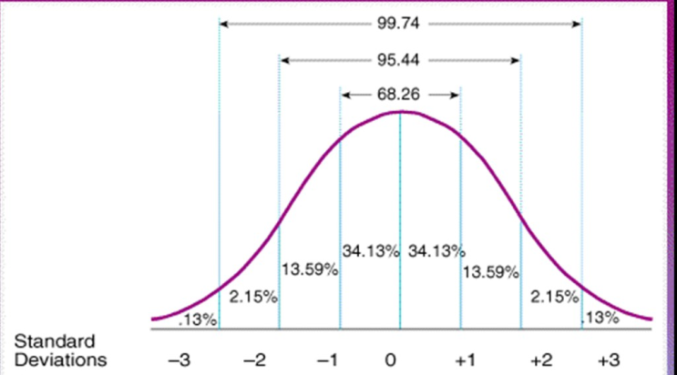
The Curse of Dimensionality
1 dimension
Pr(X₁ in the middle) = 0.9974
2 dimensions
Pr[(X₁ in the middle) AND (X₂ in the middle)] = (0.9974) (0.9974)
= 0.9946
…
20 dimensions
= (0.9974)²⁰ = 0.9493
…
1000 dimensions
= (0.9974)¹⁰⁰⁰ = 0.0740

Slide 18
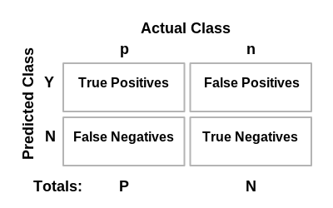
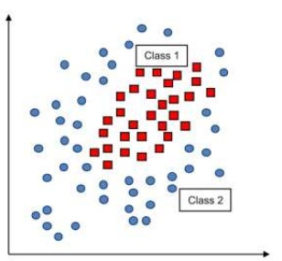
Type III Error: Right Answer, Wrong Model
Confusion Table compares possible results of predictions vs. reality
Type I Error
False Positive
“Alarm without a Fire”
Type II Error
False Negative
“Fire without an Alarm”
Confusion Table
Type I Error
Type II Error
Type III Error
Correctly reject NULL for the wrong reason
Example correctly classifies all red squares, but is obviously the wrong model

Slide 19
What’s Happening Out There?
“Reports that say that something hasn't happened are always interesting to me …
… there are known knowns;
… there are known unknowns;
… but there are also unknown unknowns – the ones we don't know we don't know. And if one looks throughout the history of our country and other free countries, it is the latter category that tend to be the difficult ones.”
-- Donald Rumsfeld, Feb 12, 2002

Slide 20
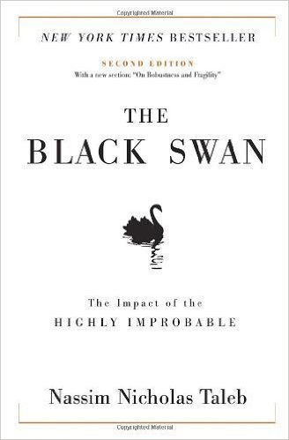
Black Swan Theory
Claim that almost all consequential events in history come from the unexpected — yet humans later convince themselves that these events are explainable in hindsight.
Black Swan Events:
(Almost) completely unexpected
Has major impact (on thinking, behavior, etc.)
Is eventually perceived as readily explainable & predictable in hindsight

Slide 21
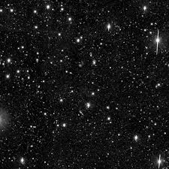
The Blackest Swan of All: Hubble Deep Field
In 1995, astronomers pointed the Hubble space telescope at a tiny speck of sky previously thought to be devoid of stars
In short … they tried to take a picture of “nothing”
The resultant image showed approx 3,000 galaxies, each comprising hundreds of millions of stars

Slide 22
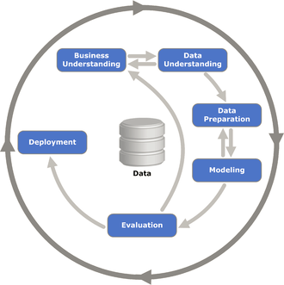
CRISP-DM: A Methodology for Data Science
Cross Industry Standard Process for Data Mining
Business Understanding
Data Understanding
Data Preparation
Modeling
Evaluation
Deployment

Slide 23

Can the Scientific Method Apply to Business?
Scientific Method
Make Observations
Think of Questions
Formulate Hypotheses
Develop Testable Predictions
Gather Data & Test Predictions
Modify Hypotheses
Develop General Theories
CRISP-DM
Business Understanding
Data Understanding
Data Preparation
Modeling
Evaluation
Deployment

Slide 24
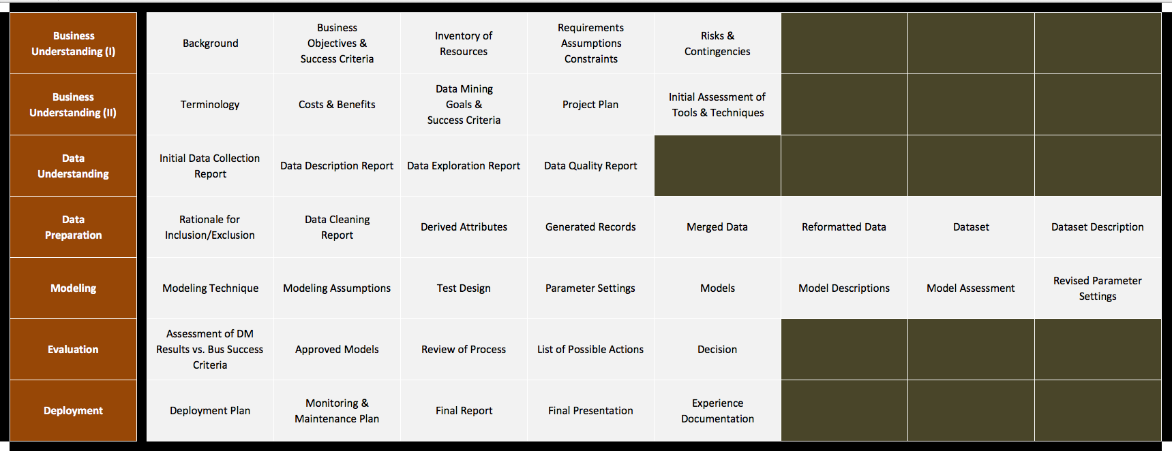
CRISP-DM: Methodology for Data Science

Slide 25

THANK YOU!

